Slide 1



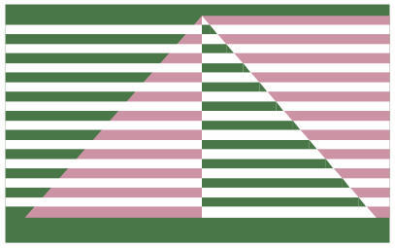
52th International Symposium on Computer Architecture (ISCA’25)
Notes:
Good morning everyone. I'm Shiheng Cao from the University of Science and Technology of China. Today I will present our work, AMALI: An Analytical Model for Accurately Modeling LLM Inference on Modern GPUs, in collaboration with my colleagues from USTC and SIAT.

Slide 2
Category
Background and Motivation
AMALI：Analytical Model Accurate modeling LLM Inference
Evaluation
Conclusion

Slide 3
Motivation: Modeling LLM Inference on GPUs
LLM Inference is GPU-Intensive
  LLMs rely on massive matrix operations (GEMMs).
  Models are run on GPUs with numerous kernel launches, using tensor cores, and complex warp behavior..
Simulator | DL-based Model | Analytical Model
⏱️ Slow | ⚙️ Needs data | ⚡ Fast
🧩 Complex | 🎲 Black-box | 🔍 Interpretable
🧠 Accurate | ❌ Architecture dependent | 🧠 Insightful Architecture-aware
Fast & Insightful Modeling is Needed
  Performance bottlenecks must be identified quickly.
  Simulators are accurate but too slow.
  DL-based models are fast but lack interpretability.
  Analytical models strike the best balance → fast, architecture-aware, and insightful.
AMALI
Notes:
Large Language Models like ChatGPT and Copilot have changed how we use AI — but running them is GPU-intensive.
These models rely heavily on GEMM operations, and they run on GPUs with tensor cores, multi-level caches, and complex warp behavior.
To understand and optimize their performance, we need tools that are not only accurate, but also fast and insightful.
Simulators are accurate, but way too slow to be practical.
DL-based models are faster, but they’re black boxes — we can't tell why performance changes.
That’s where analytical models come in. They’re fast, they’re interpretable, and they’re architecture-aware.
And that’s why we built AMALI — to make LLM inference modeling both accurate and practical.

Slide 4
Interval Analysis Based method
e.g. GCoM [ISCA ’22], MDM [MICRO ’20], GPUMech [MICRO ’14]
Warp
Warp
Warp
Warp
Warp
Warp
Interval-based GPU Analytical Models
Use a single representative warp to estimate kernel behavior
Split execution into intervals with stall analysis
  Instruction latency from microbenchmark
  AMAT from cache simulation
Warp
Warp cluster and select
Instruction issue timeline
Interval analyze
dependency
dependency
Instruction issue timeline
Instruction issue timeline
Add extra contention
Total cycles
An instruction; different color means from different warp
A cycle not issuing any instruction
Notes:
In this setction, we review prior analytical models that rely on interval analysis, such as GPUMech [MICRO '14], MDM [MICRO '20], and the most recent GCoM [ISCA '22].
These models adopt a single-warp abstraction: they pick a representative warp, then perform interval analysis to identify when and why the warp stalls — due to dependencies, memory latency, or resource contention.
As shown on the right, they simulate an instruction issue timeline. Intervals indicate stall cycles; arrows show issued instructions. Some instructions depend on earlier results — so stalls occur between them.

Slide 5
Modeling Extra Stall Cycles
Beyond naive interval model
GPUMech:
  Multi warp model
MDM:
  Memory-side contention
(MSHR, NoC, DRAM)
GCoM:
  Compute and Memory stalls
Load imbalance stalls
Models per-core/sub-core
microarchitecture in modern GPUs
Instruction issue timeline
Single warp model
Instruction issue timeline
GPUMech
Instruction issue timeline
Interval Analysis
Memory-Side Contention
(MSHR / NoC / DRAM stalls)
MDM
Interval Analysis
Memory-Side Contention
(MSHR / NoC / DRAM stalls)
GCoM
Compute-Side Stalls
(Sub-core FU, L1D banks)
Load Imbalance Modeling
Notes:
While the interval-based model gives us a foundation, real GPU performance is affected by more than dependencies.
GPUMech instroduces Multi warp model to model gpu behavior
MDM introduces memory-side contention modeling — it estimates queuing delay due to MSHR, NoC, and DRAM backpressure.
GCoM goes further by modeling the detailed microarchitectural characteristics of modern GPUs:
Compute structural stalls from limited per-sub-core functional units
Memory structural stalls due to fewer L1D banks
Idle stalls caused by intra- and inter-core load imbalance
These are modeled by breaking down execution into more detailed CPI stack components — enabling higher accuracy.

Slide 6
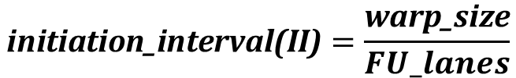
Tensor Core Modeling
Accurate Tensor Core model is essential for modeling LLM inference.
However, prior methods fail to capture its unique execution behavior
FP
FP
FP
FP
FP
FP
FP
FP
Why Initiation Interval Fails for Tensor Cores
  Prior models (incl. GCoM) use initiation interval to model compute contention
  CUDA cores: threads issue independently. Tensor cores: warp-level operations collaboratively
FP
FP
FP
FP
FP
FP
FP
FP
Issue Issue 4/8 Issue 8/8 Done
$$\text{initiation}\text{_}\text{interval}\text{(}\text{II}\text{)}=\frac{\text{warp}\text{_}\text{size}}{FU_lanes}$$
Tensor core
Tensor core
Tensor core
Tensor core
Issue Executing Executing Done
Notes:
However, previous methods have significant limitations when applied to LLM inference. The first major issue lies in tensor core modeling.
As we discussed earlier, LLM inference heavily relies on GEMM kernels that utilize tensor cores. But previous work directly applied CUDA core modeling approaches to tensor cores - specifically, they used the initiation interval method.
Let me explain the key problem here. Looking at the upper diagram on the right, let's assume we have a warp with 8 threads and 4 FP units. Due to insufficient compute units, the warp must be split across two cycles for execution. This is how the initiation interval approach models the functional unit contention.
But here's the critical difference: tensor cores don't work this way. Tensor cores use a collaborative execution model where threads work together cooperatively. This fundamental difference means that for tensor core instructions, the number of issue and execution cycles is completely independent of both the warp size and the number of compute units.
This collaborative nature of tensor cores makes the traditional initiation interval modeling approach fundamentally flawed when applied to tensor core operations, leading to inaccurate performance predictions for LLM inference workloads.

Slide 7
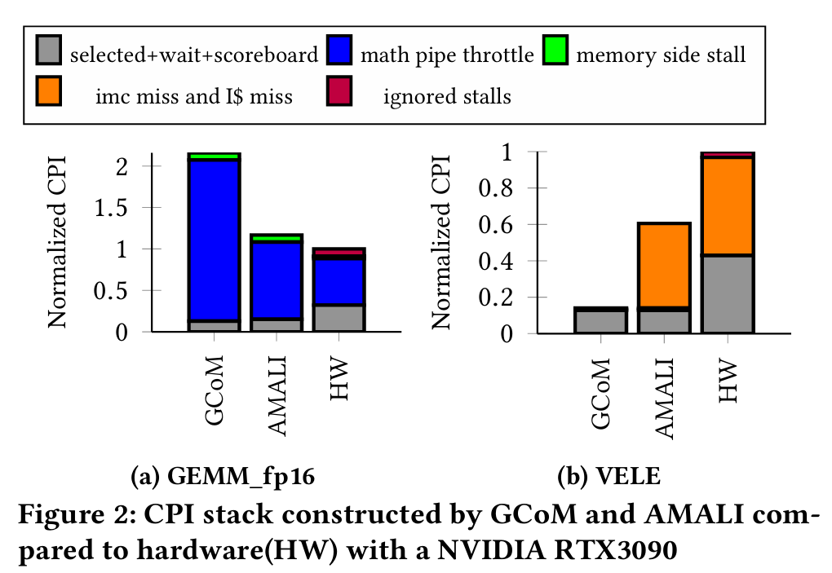
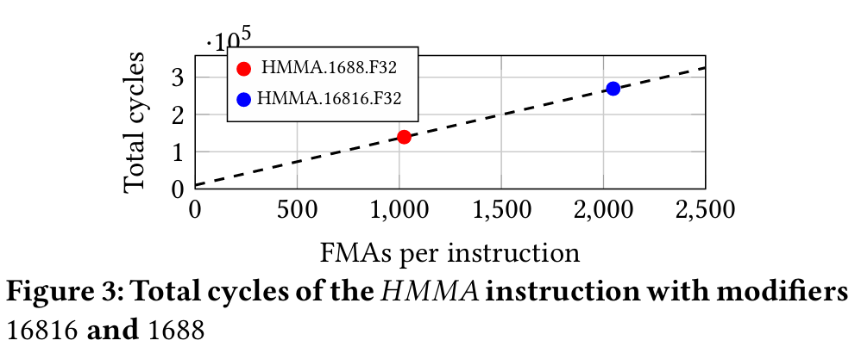
Tensor Core Modeling
Instruction modifiers influence Instruction behavior
(e.g., HMMA.16816 vs HMMA.1688)
Throughput-based method improves accuracy
Typical Tensor core instruction
𝐻𝑀𝑀𝐴.16816.𝐹32,𝑅0,𝑅8,𝑅5,𝑅0
Initiation Interval values for HMMA.16816 on RTX3090
Method | Values
GCoM | 32
AMALI | 16
Notes:
Another important insight is instruction modifiers influencing tensor core behavior. We conducted an experiment where we modified the SASS instruction modifiers in a tensor core-dominated benchmark. The original instruction was HMMA.16816 - this means multiplying a 16×8 matrix with an 8×16 matrix to produce a 16×16 result matrix. We then changed the modifier from 16816 to 1688, which reduces the computation by half - now we're computing a 16×8 result instead of 16×16.
Looking at the left graph : the execution time dropped by exactly half, from the blue point to the red point. This reveals something crucial about tensor cores - they operate at a fixed throughput. When we halved the computational workload, the cycles also halved proportionally.
This behavior is fundamentally different from CUDA cores. The right side shows how different initiation interval values affect modeling results. The blue portion represents delays caused by computing resource contention. Notice that GCoM's value is twice our modeling approach, and the final results are also roughly twice as large. This demonstrates that the throughput-based CPI estimation we propose significantly improves accuracy compared to traditional initiation interval approaches.
The key insight is that tensor core instructions execute with predictable throughput characteristics, making the number of issue and execution cycles independent of both warp size and the number of compute units.

Slide 8
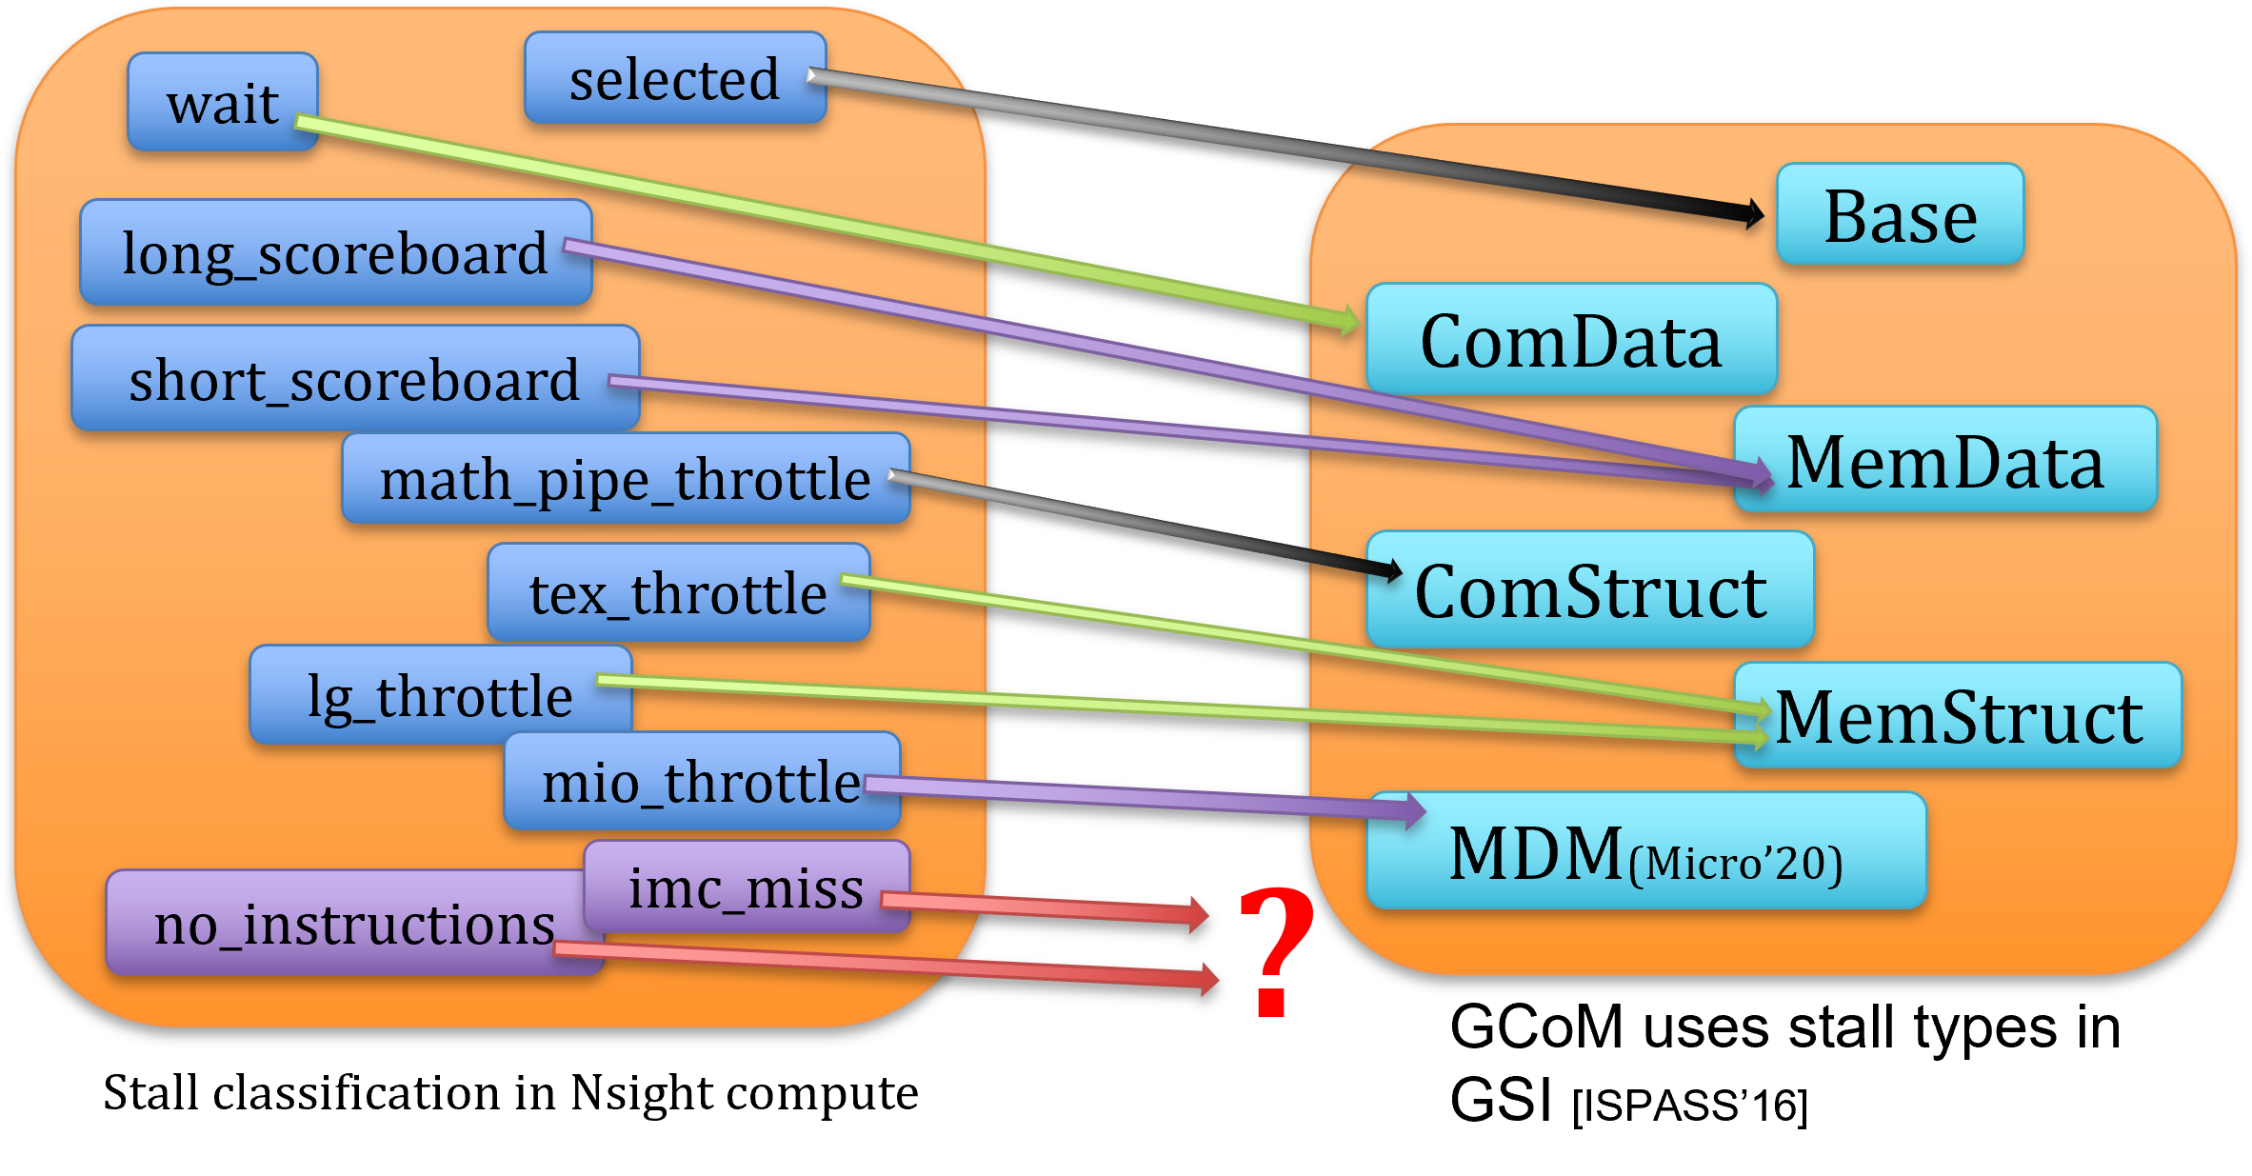
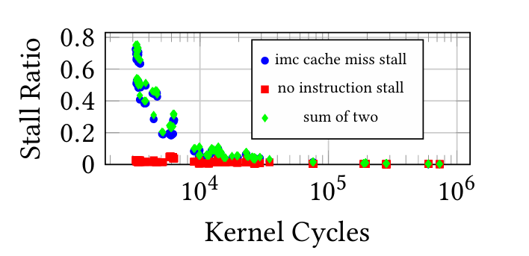
Ignored Immediate Constant Cache(IMC) miss & Instruction Cache(IS) miss
Comparing stall classification in HW and stall types used in prior work.
IMC and IS stalls account for significant stall ratio in LLM inference.
LDC, STC has been modeled in cache simulation.
Implicit constant memory access.
(e.g. IMAD.MOV.U32 R1, RZ, RZ, c[0x0][0x28] )
Instruction cache miss is ignored.
Notes:
Beyond tensor core modeling, there's another critical limitation in existing approaches - ignored cache miss scenarios that significantly impact LLM inference performance.
When we compared the stall classification used in prior work with the actual hardware stall types reported by Nsight Compute, we discovered two major gaps: Immediate Constant Cache (IMC) miss and Instruction Cache (IS) miss stalls were completely overlooked.
The impact of this oversight is substantial. Looking at the bottom graph, our analysis of Llama-3 inference on RTX 3090 reveals that these two stall types account for a significant portion of execution delays. The blue dots represent IMC cache miss stalls, while the red squares show "no instruction" stalls - and you can see their combined impact (green diamonds) represents a considerable fraction of the total stall ratio.
Previous work did model some constant memory accesses through LDC and STC instructions. However, the more common pattern in modern GPU code is implicit constant memory access - where constant variables are directly encoded into instructions themselves. For example, an instruction like showed in green includes the constant access directly in the instruction encoding.
This means that when these implicit constant accesses miss the IMC, they create stalls that existing models simply don't account for. Similarly, instruction cache misses create execution bubbles that prior work ignored entirely.

Slide 9
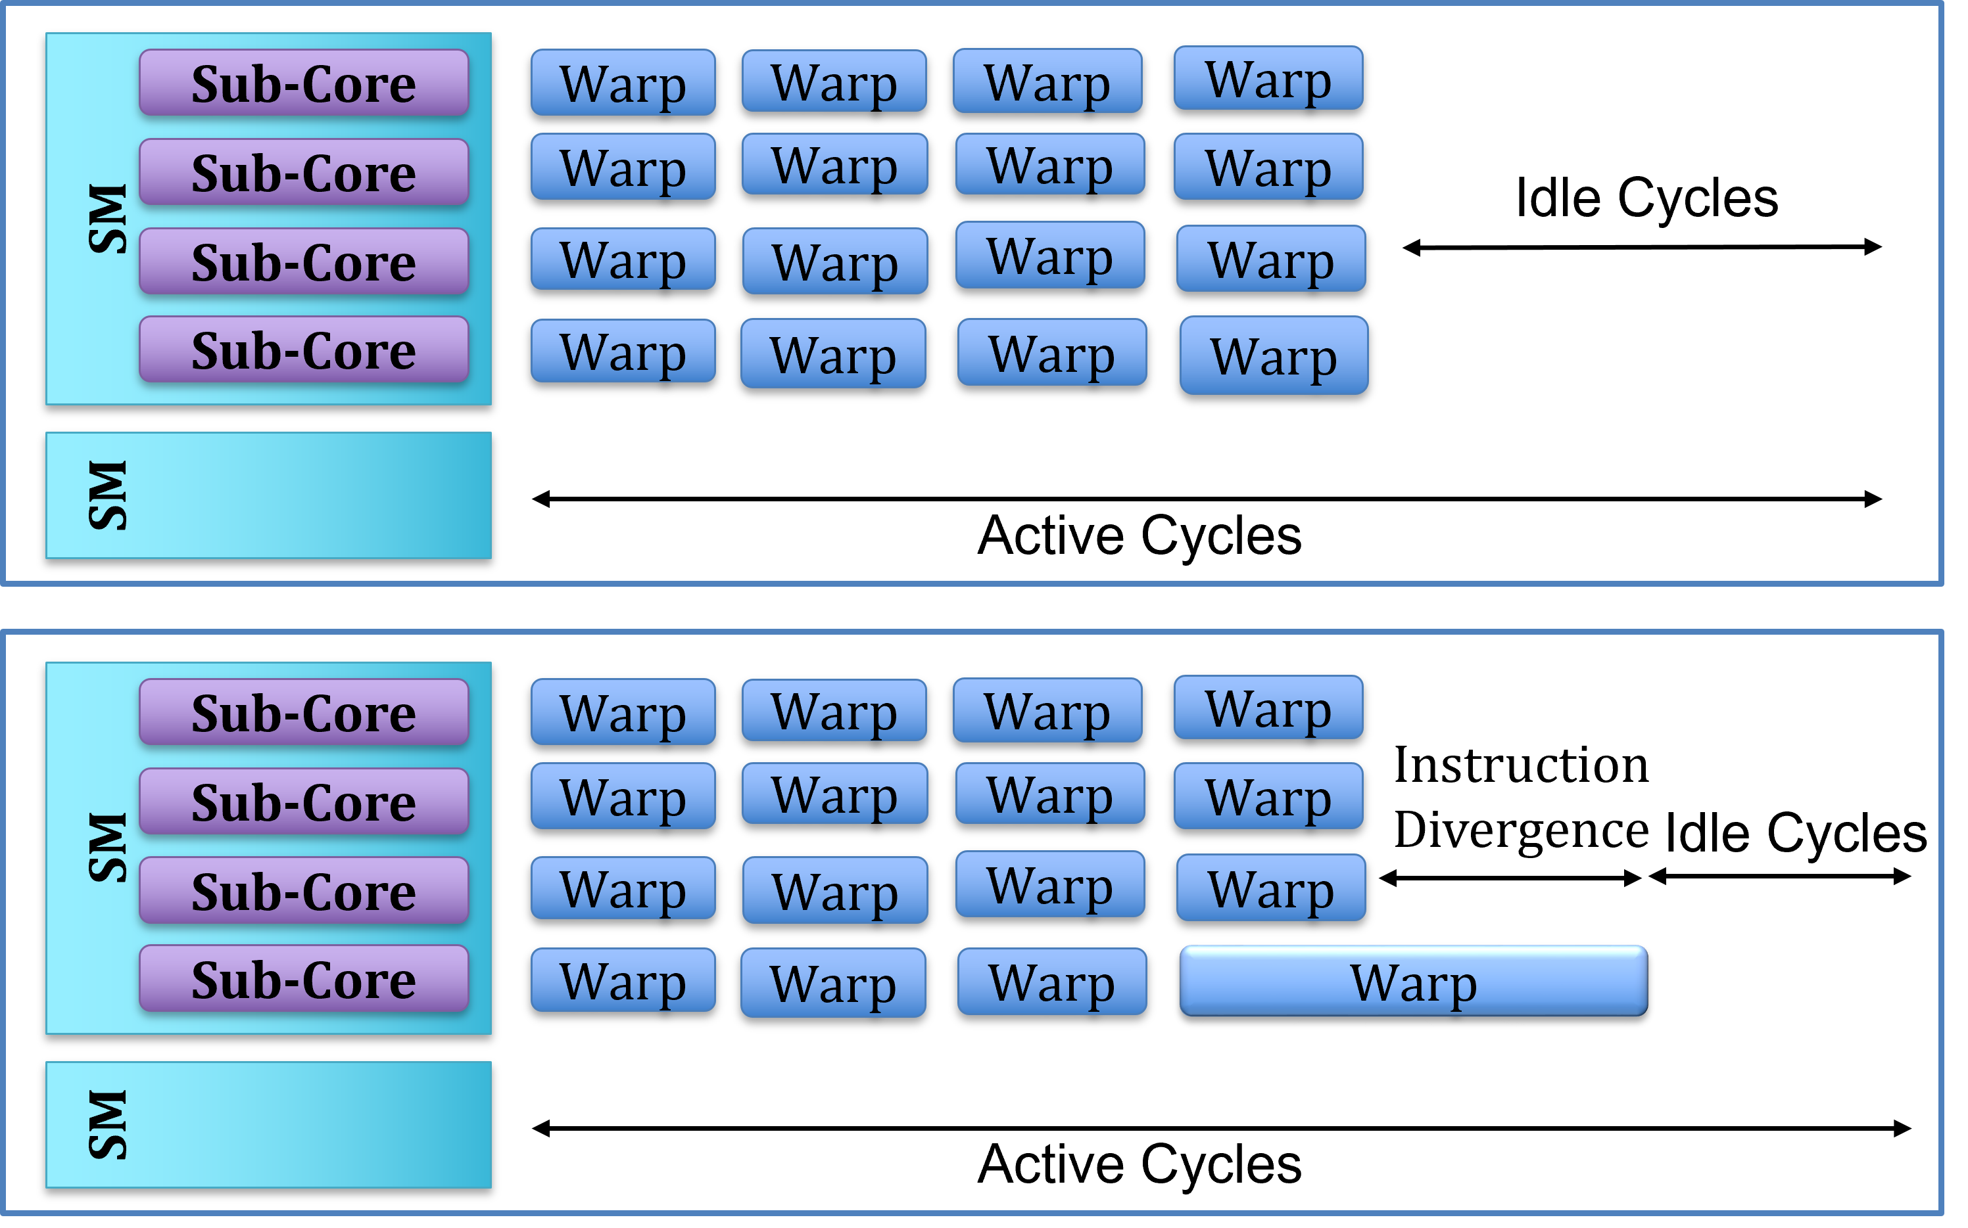
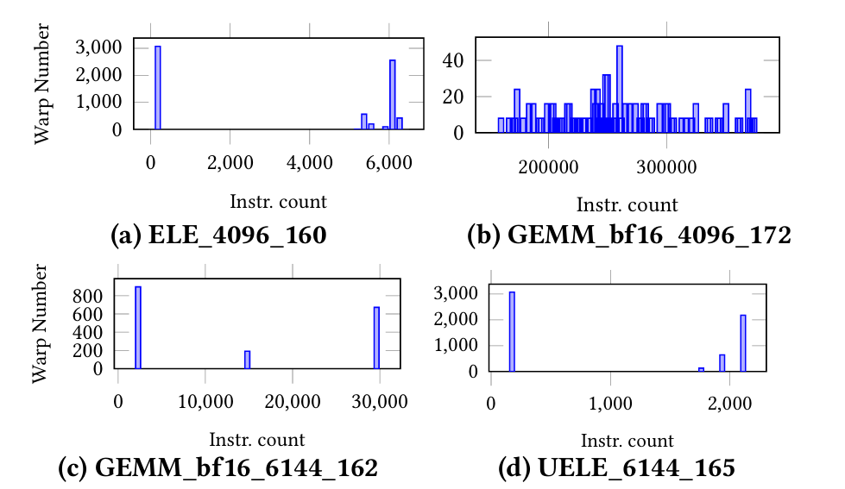
Limitations of Uniform Warp Assumption
Existing models assume uniform warp behavior, leading to incorrect modeling
LLM inference shows significant warp instruction divergence
Not captured by prior analytical models
Notes:
The third critical limitation is the uniform warp behavior assumption.
Existing models assume all warps execute uniformly, but LLM inference shows significant instruction divergence. The histograms demonstrate this - some warps execute hundreds of instructions while others execute tens of thousands. This creates idle cycles that prior analytical models completely miss, limiting their accuracy for LLM workloads.

Slide 10
Summary of Limitation
Still inaccurate for LLMs due to tensor core behavior, launch latency and warp diversity.
Accurate Tensor Core Model
Ignored Constant Cache Miss & Instruction Cache Miss
Warp instruction divergence
Notes:
Previous GPU performance modeling approaches face three critical limitations when applied to LLM inference:
First, inaccurate tensor core modeling. Existing methods directly apply CUDA core approaches using initiation intervals to tensor cores. However, tensor cores use collaborative execution where threads work cooperatively, making execution cycles independent of warp size and compute units. This fundamental difference leads to significant modeling errors.
Second, ignored cache miss scenarios. Prior work overlooks two major stall types: Immediate Constant Cache misses and Instruction Cache misses. Our analysis shows these account for substantial execution delays in LLM inference, yet existing models completely ignore them.
Third, uniform warp behavior assumption. Current models assume all warps execute uniformly, but LLM inference exhibits significant instruction divergence - some warps execute hundreds of instructions while others execute tens of thousands. This creates idle cycles that analytical models miss entirely.
These limitations make existing approaches fundamentally inadequate for accurate LLM inference performance prediction.

Slide 11
Category
Background and Motivation
AMALI：Analytical Model Accurate modeling LLM Inference
Evaluation
Conclusion

Slide 12
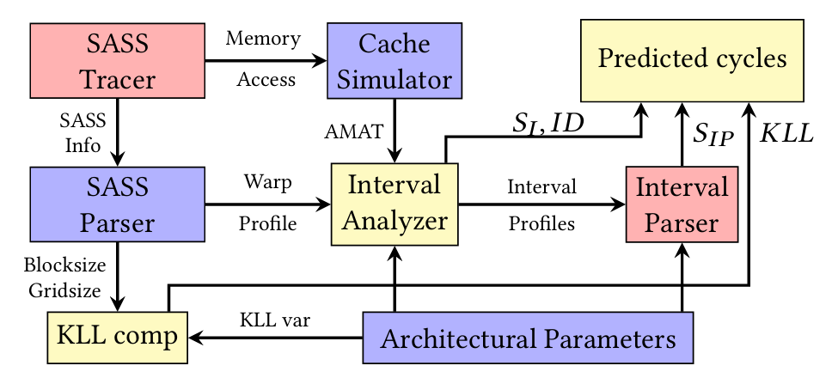
AMALI Overview
Notes:
To overcome these limitation, we proposed AMALI. It consists of seven components.
SASS Tracer
Dynamically collects SASS instruction traces from real GPU execution with NVBit.
SASS Parser
Decodes SASS instructions to extract operation type and data dependencies.
Cache Simulator
Models cache behavior to get average memory access time.
Interval Analyzer
Divides warp execution into intervals based on data dependencies and issue constraints.
Interval Parser
Analyzes each interval to catch stalls caused by compute/memory throughput.
KLL comp
Use kernel launch latency to model Immediate Constant Cache(IMC) miss and Instruction Cache(IS) miss

Slide 13

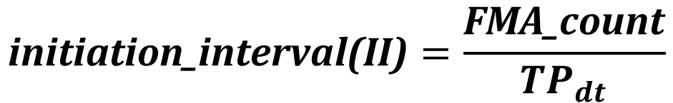
Tensor Core Modeling
Uses instruction modifiers
  (e.g., HMMA.16816 vs HMMA.1688)
Throughput-based method improves accuracy
$$\text{initiation}\text{_}\text{interval}\text{(}\text{II}\text{)}=\frac{\text{FMA}\text{_}\text{count}}{{TP}_{dt}}$$
It also models the Latency of single Tensor core Instruction
$${Latency}_{TC }={II}_{TC}$$
Notes:
In interval Parser, we capture stalls caused by contention in memory and computing. For stall caused by contention of tensor core
We introduced throughput-based CPI estimation. We use instruction modifiers to determine the actual computational workload. We calculate the initiation interval using FMA count from instruction modifiers divided by tensor core throughput from microbenchmarks.
And We set the latency of tensor core instructions as the initiation interval value, reflecting the collaborative execution nature of tensor cores.

Slide 14
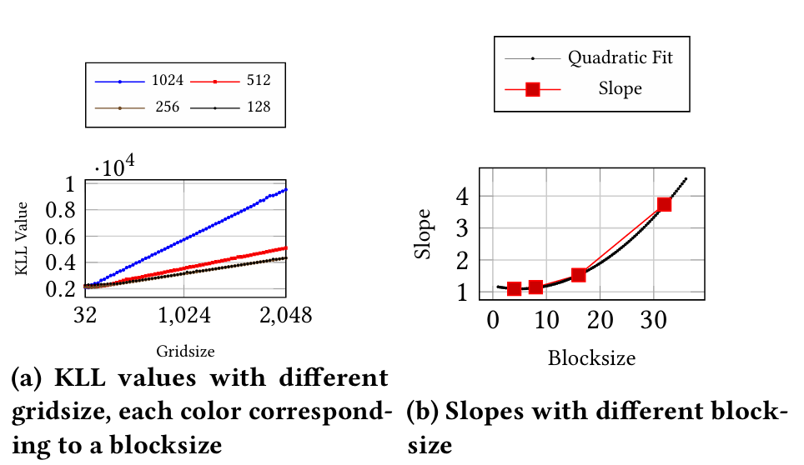


Kernel Launch Latency and Instruction Divergence
Kernel Launch Latency (KLL)
  models cache-related stalls,
  accounts for implicit constant memory and instruction cache
Based on microbenchmark, modeling KLL corresponding to grid size (GS) and block size (BS)
$$\text{KLL} \text{=}\text{s} \text{·}\text{GS} \text{+}\text{k}$$
$$\text{s} \text{=}\text{α} \text{· }{(BS)}^{2}\text{ +}\text{β} \text{· (}\text{BS}\text{) +}\text{γ}$$
LLM kernels show high warp instruction variability
AMALI models instruction divergence explicitly
𝐼𝐷 = (max_sub-core_Instr − $I_{\text{SC}\text{_}\text{Repr}\text{.}\text{warp}}$)/𝐼𝑠𝑠𝑢𝑒𝑅𝑎𝑡𝑒
Notes:
First is Kernel Launch Latency modeling. We need to model cache-related stalls, specifically constant memory cache misses and instruction cache misses. These stalls mainly happen when kernels start up and have a big impact on LLM performance.
To understand this, we ran empty CUDA kernels with different grid sizes and block sizes, then profiled them using Nsight Compute. The profiling results showed that the execution cycles of these empty kernels are dominated by these two types of stalls - constant cache misses and instruction cache misses.
From our microbenchmark data, we found that kernel launch latency follows this formula: KLL equals s times grid size plus k. The relationship is linear with grid size, but the slope s changes non-linearly with block size. So we use a quadratic function for s. All the coefficients come from benchmark measurements.
Second is instruction divergence modeling. Our approach explicitly captures this divergence. We calculate the difference between the maximum instructions executed by any warp on a sub-core and the instructions from a representative warp, then divide by the issue rate.

Slide 15




Highlight AMALI
Model tensor core with throughput and modifier
$$\text{initiation}\text{_}\text{interval}\text{(}\text{II}\text{)}=\frac{\text{FMA}\text{_}\text{count}}{{TP}_{dt}}$$
$${Latency}_{TC }={II}_{TC}$$
Model launch latency with equation corresponding to gird size and block size
$$\text{KLL} \text{=}\text{s} \text{·}\text{GS} \text{+}\text{k}$$
$$\text{s} \text{=}\text{α} \text{· }{(BS)}^{2}\text{ +}\text{β} \text{· (}\text{BS}\text{) +}\text{γ}$$
Model warp instruction divergence by difference between representative warp and the largest one
𝐼𝐷 = (max_sub-core_Instr − $I_{\text{SC}\text{_}\text{Repr}\text{.}\text{warp}}$)/𝐼𝑠𝑠𝑢𝑒𝑅𝑎𝑡𝑒
Notes:
AMALI builds on interval analysis but introduces three key improvements for LLM inference:
First, accurate tensor core modeling using throughput-based calculations instead of traditional initiation intervals.
Second, kernel launch latency modeling that captures cache-related stalls during kernel startup - something previous models missed entirely.
Third, instruction divergence modeling that accounts for idle cycles when warps finish at different times in LLM workloads.
These three improvements make AMALI significantly more accurate for LLM performance prediction.

Slide 16
Category
Background and Motivation
AMALI：Analytical Model Accurate modeling LLM Inference
Evaluation
Conclusion

Slide 17
Evaluation Setup
Platform: NVIDIA A100
Benchmark: Llama3-8B/15B, DeepBench, Rodinia
  Llama3 inference with different prompt length and batch size.
  CONV and GEMM from DeepBench, and BP, B+, DWT, PF from Rodina
Compare with GCoM [ISCA’22] using real GPU traces and metrics
Notes:
We evaluate AMALI on NVIDIA A100 using three benchmark suites.
For LLM workloads, we test Llama3-8B and 15B inference with different prompt lengths and batch sizes.
For general GPU kernels, we select several kernels from Rodinia and DeepBench.
We compare against GCoM from ISCA 2022 using real GPU traces and hardware metrics to ensure fair evaluation.

Slide 18
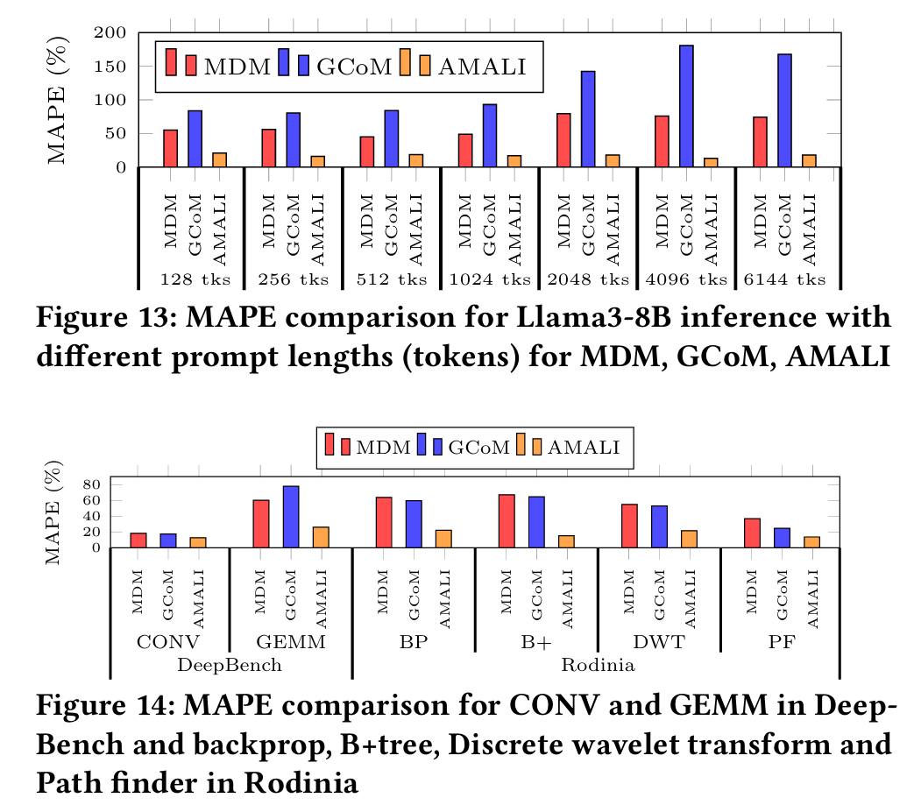
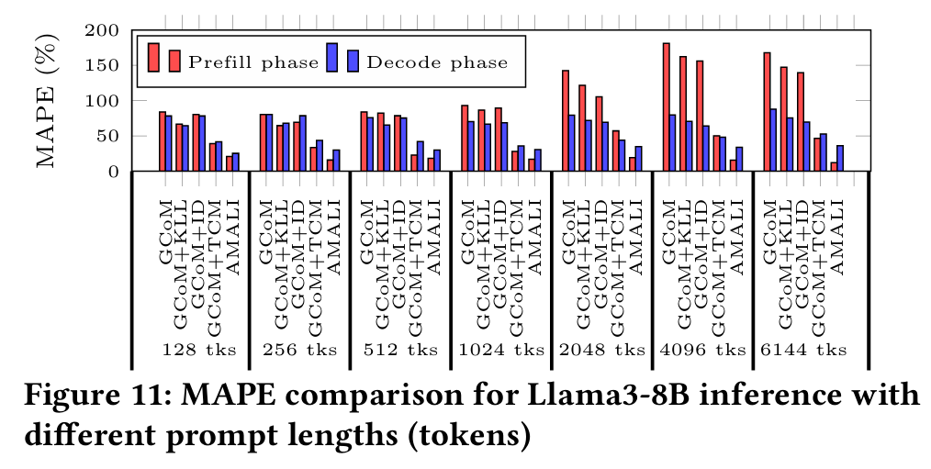
Accuracy Results
AMALI reduces MAPE against to real GPU from 127.6% to 23.6% (Compared to GCoM [ISCA’22] )
Notes:
AMALI significantly improves prediction accuracy, reducing error from 127.6% to 23.6% compared to GCoM - more than a 5x improvement.
For LLM inference, AMALI consistently outperforms both MDM and GCoM across all prompt lengths from 128 to 6144 tokens, maintaining low error rates in both prefill and decode phases.
For general GPU kernels from DeepBench and Rodinia, AMALI again shows consistently lower error rates across all workloads.
This demonstrates that AMALI's three key improvements are essential for reliable LLM performance prediction.

Slide 19
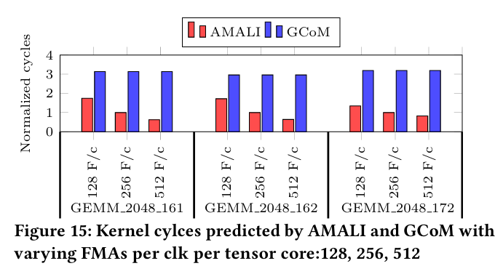
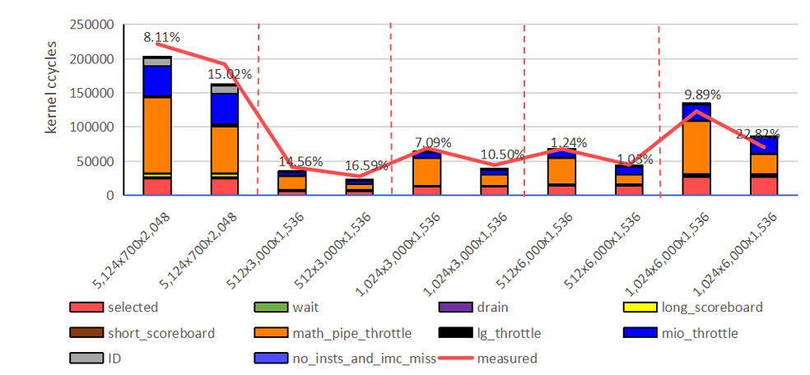
Design Space Exploration
Simulate H100 with
    double A100 tensor core throughput
Accurately predicts GEMM kernel cycle reduction
Model A100: A100 SASS traces
+ A100 config
Model H100: A100 SASS traces + H100 config
Capture cycle reduction
MAPE in range 1.03% to 22.82%
Two bars split by red dash line: A100(left) H100(right)
Notes:
AMALI enables accurate design space exploration for future GPU architectures.
We simulate H100 with double A100 tensor core throughput and accurately predict GEMM kernel cycle reduction. Our approach uses A100 SASS traces with different configuration parameters to isolate architectural improvements.
The results show AMALI captures cycle reduction from A100 to H100 with prediction errors ranging from just 1.03% to 22.82%. The bottom graph shows our predictions closely track measured performance across different configurations.
Importantly, AMALI significantly outperforms GCoM in predicting performance differences across varying tensor core throughputs. GCoM fails because it uses CUDA core modeling for tensor cores.
This demonstrates AMALI is accurate enough for early-stage GPU design space exploration.

Slide 20
Category
Background and Motivation
AMALI：Analytical Model Accurate modeling LLM Inference
Evaluation
Conclusion

Slide 21
Conclusion
AMALI enables accurate GPU modeling for LLM inference
Precise modeling of
  tensor core unique behavior,
  constant cache miss & instruction cache miss,
  warp instruction divergence
Fast and insightful for software and hardware design
  MAPE of 23.6% against A100 GPU

Slide 22
Thank You
ありがとう
谢谢
Questions?
Shiheng Cao @ University of Science and Technology of China
caosh2020@mail.ustc.edu.cn
Notes:
Thank you for your attention. I'm happy to take any questions.

